Slide 1
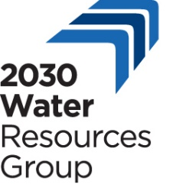
Global Webinar on the Impact and Recovery from COVID-19 in the Irrigation and Drainage Sector
Employment Intensive Investments- Programs “EIIP” : Lessons learned from Tunisia
Presented by : Kamel BOULEHMI
EIIP NATIONAL COORDINATOR-ILO/EC Project TUNISIA
boulehmi@ilo.org
Supported by : Jad BOUBAKER
EIIP Project Manager-ILO/EC Project TUNISIA
boubaker@ilo.org

Slide 2
Introduction
COVID 19 pandemic has impacted badly a lot of sectors economically, socially and environmentally.
The irrigation and drainage sector has been facing some serious challenges affecting the life of different actors:
disruptions in the provision of irrigation and drainage services
delay of infrastructural maintenance.
The ILO’s Employment-intensive works approach successfully-tested in Tunisia demonstrates to be a solution to the previously mentioned issues.
So, what is the Employment-Intensive Works Approach about?

Slide 3
Employment-intensive investment approaches
Main purpose: Enhances the employment outcomes of public investments in infrastructure and environmental works supporting groups of society in vulnerable situations.
Approach to be applied wherever technically feasible and economically viable to develop and maintain infrastructure while producing a positive impact on employment creation and income generation.
The ILO’s emphasis is on the quality of works, productivity, optimizing local resources, capacity-building and the creation of decent employment.
Irrigation works can address the new demand for creating jobs as a result of the economic impact of COVID-19, with additional preventive and mitigation measures.

Slide 4
ILO’s Employment-intensive Investment Program
1. A holistic, intersectoral approach: employment issues, poverty reduction, improvement of working conditions, gender equality…
2. A local resources based approach: local materials, local knowledge, local institutions, local SMEs, local labour, …)
3. Enabling legal framework to facilitate access to public contracts and fostering transparency in the allocation of public resources
4. Efficient and employment-friendly management of contracts (cost control, social and environmental clauses,…)

Slide 5
ILO’s Employment-intensive Investment programs
5. Devolution and related institutional reforms, social organization, local planning and procurement within local community
7. Strategic partnerships between the public and the private sector, through contractual systems and procedures
6. Training sessions (senior managers, decision-makers, social partners,,…)

Slide 6
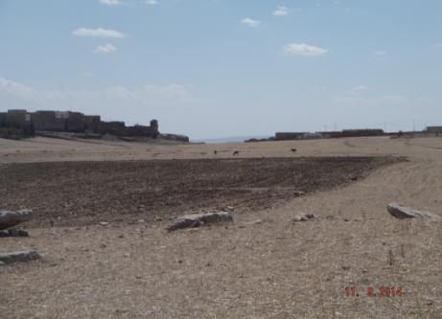
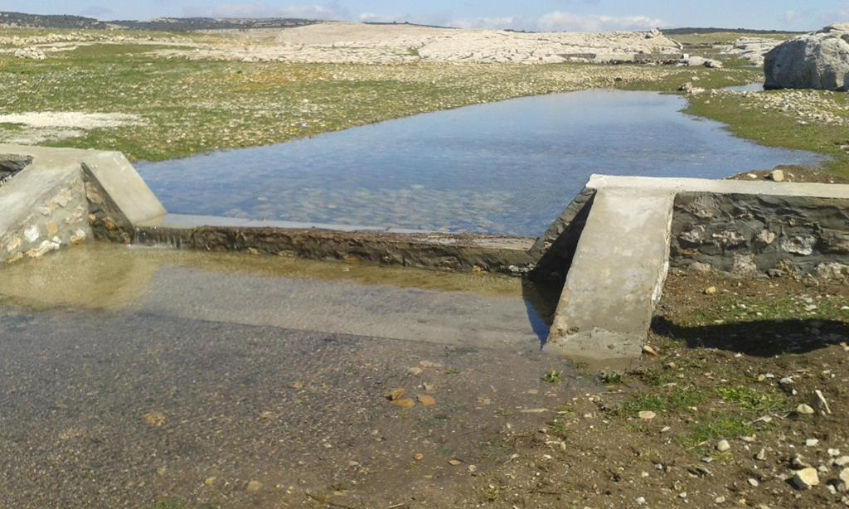
Integrated local development and hydroagricultural water resources project : Example Hydro-agricultural arrangements at KESRA-Tunisia
Before
After

Slide 7
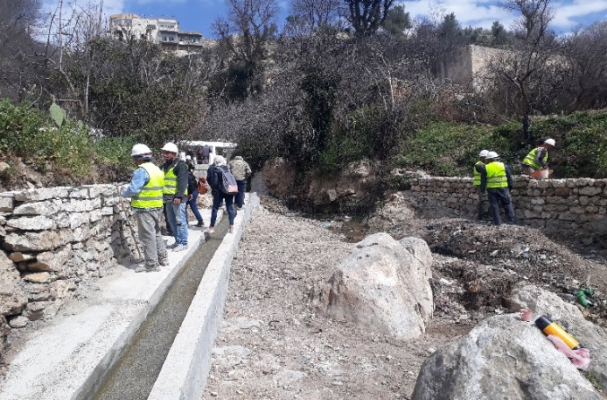
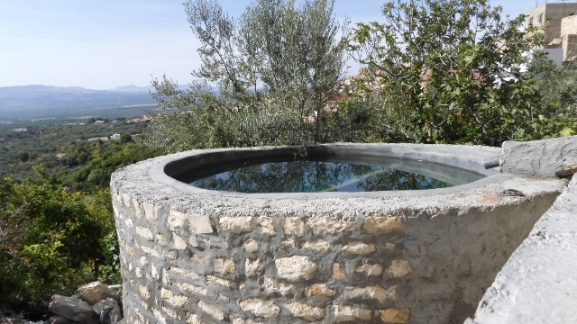
1. Water efficiency:
50 Ha irrigable agricultural land
Construction of Irrigation canals about 2 km and 10 water tanks of 30 m3 using local stones (rugged ground with a sharp slope
Near to 3000 Working day using
3 SME Contracted
Better water distribution and reduced irrigation time

Slide 8
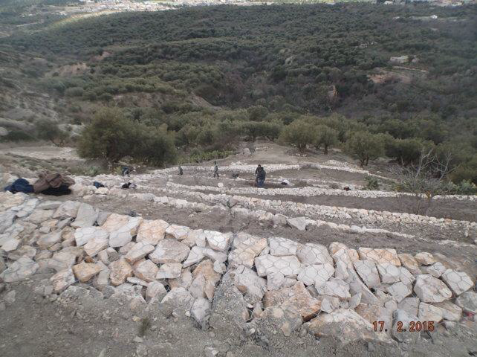
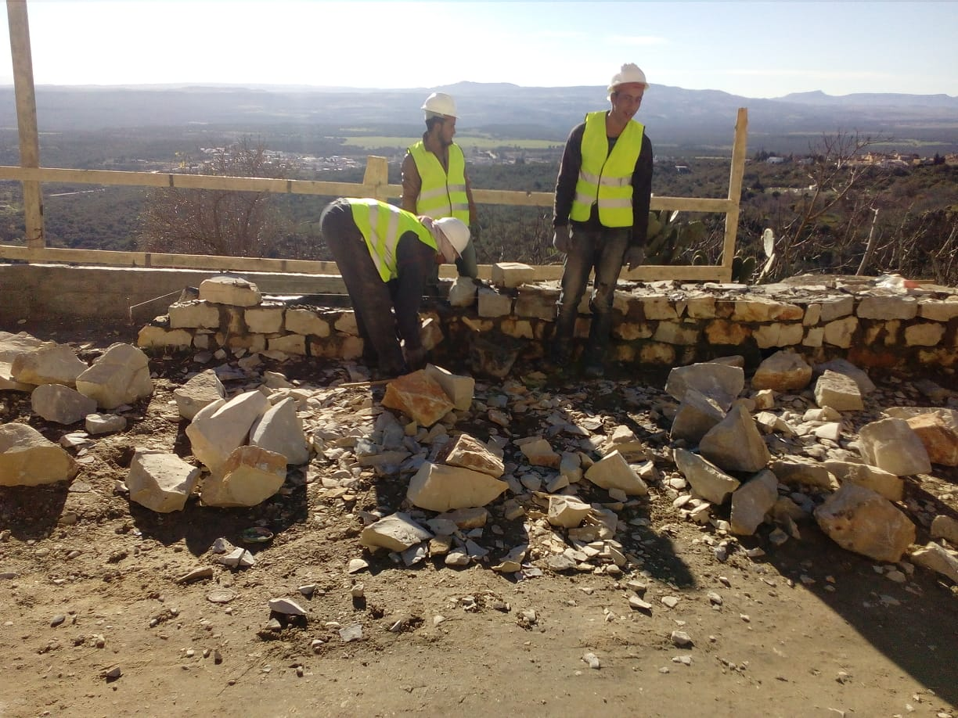
2. Water and soil conservation:
Construction of retaining walls (240 ml)using local stones and gabions (600 m3)
Recovery of 2ha of exploitable land
Planting new figs and returning to market gardening
Near to 1200 Working day
1 SME
1 Cooperative (Community Contract)

Slide 9
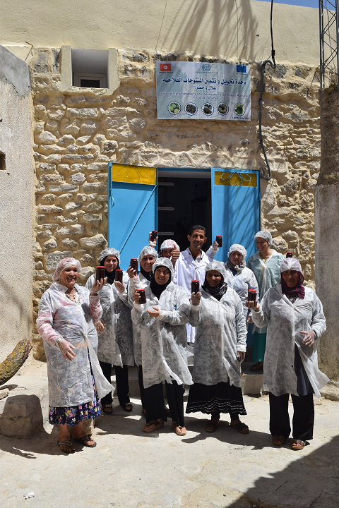
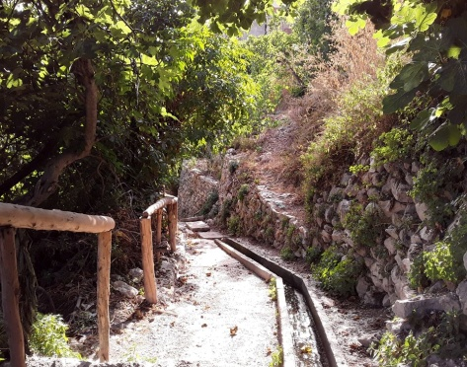
3. Eco-tourism:
Construction of an eco-tourism tour 1 km
Artisanal unit for processing local agricultural products
20 Rural Women beneficiaries
1 SME Contracted
700 Working Day

Slide 10
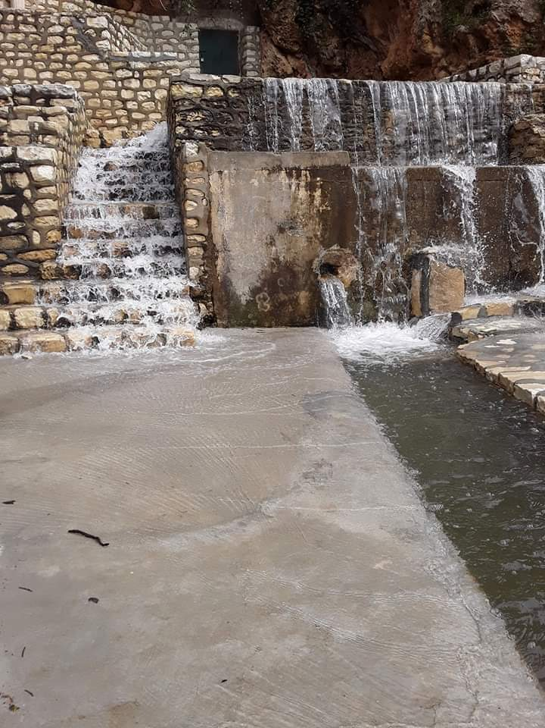
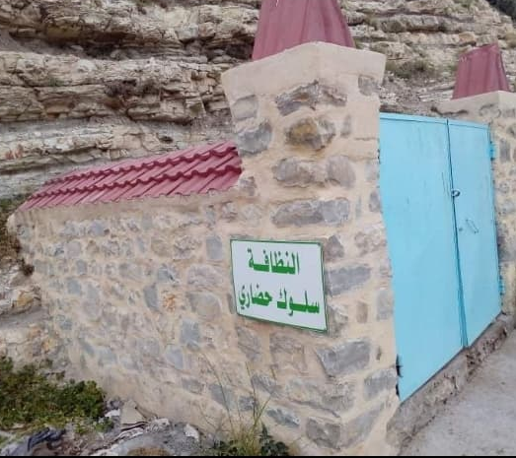
4. Protection of the environment:
Installation of stone niches and iron cages for the collection of plastic waste
Elimination of water losses

Slide 11
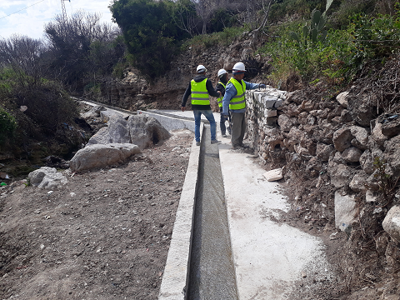
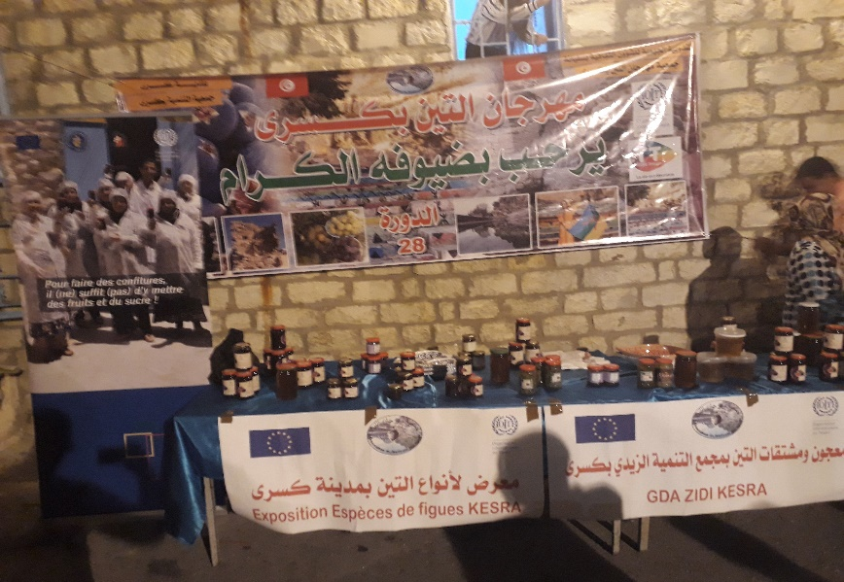
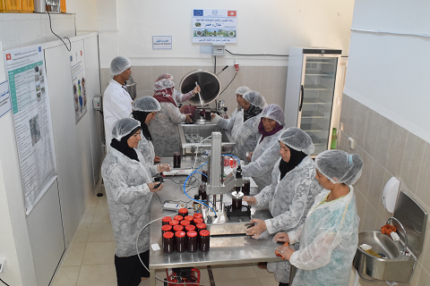
5. Community Impact
Found injection by creating direct Working day
Hiring of a handicap in the monitoring of irrigation and the management of water distribution
Hiring of women during the maintenance works
Building capacity for 140 farmers beneficiaries
Farmers' income increases by 60%
Improvement of environmental protection
Organization of festival of local products of farmers

Slide 12
THANK YOU FOR YOUR ATTENTION

