Slide 1



MSME Productivity, Inclusive Growth and Decent Work Creation
  Mark Keese, Head of Skills and Employability Division, OECD
  Martha Newton, Deputy Director-General for Policy, ILO

Slide 2
Main messages
Labour productivity is a key long-term driver of income growth which has contributed to poverty reduction in many emerging economies.
However, the relationship between productivity growth and wage growth cannot be taken for granted (i.e. decoupling experience of some OECD countries).
Labour productivity gaps between MSMEs and large companies are sizeable and have widened over the last 10 years.
Labour productivity gaps by firm size and sectors contribute to rising income inequalities worldwide, thus calling for adequate policies to reduce them.

Slide 3
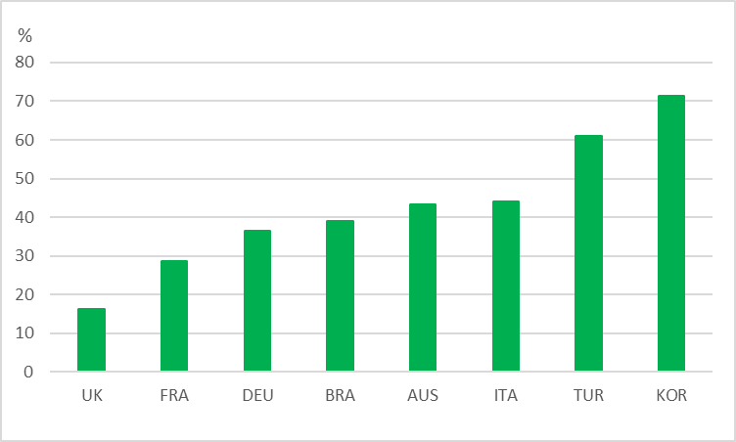
Labour productivity gaps by firm size are sizeable
Labour productivity gap between SMEs and large companies in selected G20 economies, 2019
Percentage gap in average labour productivity, value-added per person employed, national currencies
Note: Labour productivity gap = 100 – (average SME productivity/average large-firm productivity)*100. Labour productivity is defined as value added per person employed. SMEs are companies with up to 249 people employed. Large companies are companies with 250+ people employed. Data for Brazil and Korea refer to 2015. Source: OECD calculations based on OECD SDBS database.

Slide 4
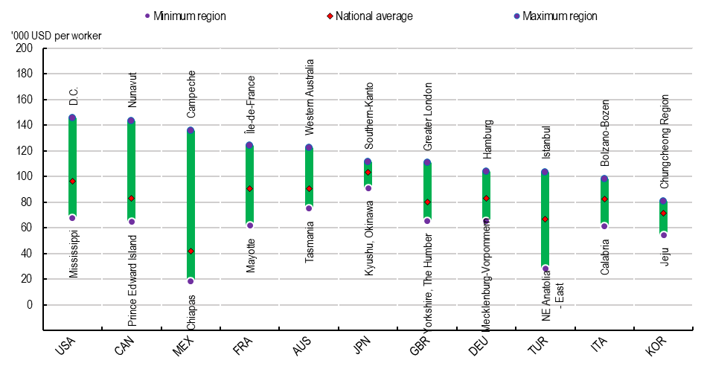
There are strong regional variations in Labour Productivity levels
Labour productivity regional disparities in selected G20 countries, large regions (TL2), 2018
Labour productivity measured as gross value added per person employed
Note: 2018 or latest available year. Data for Australia and Canada refer to 2017; data for Japan to 2016; data for Turkey to 2015.
Source: OECD (2020), OECD Regions and Cities at a Glance 2020, OECD Publishing, Paris, https://dx.doi.org/10.1787/959d5ba0-en.

Slide 5
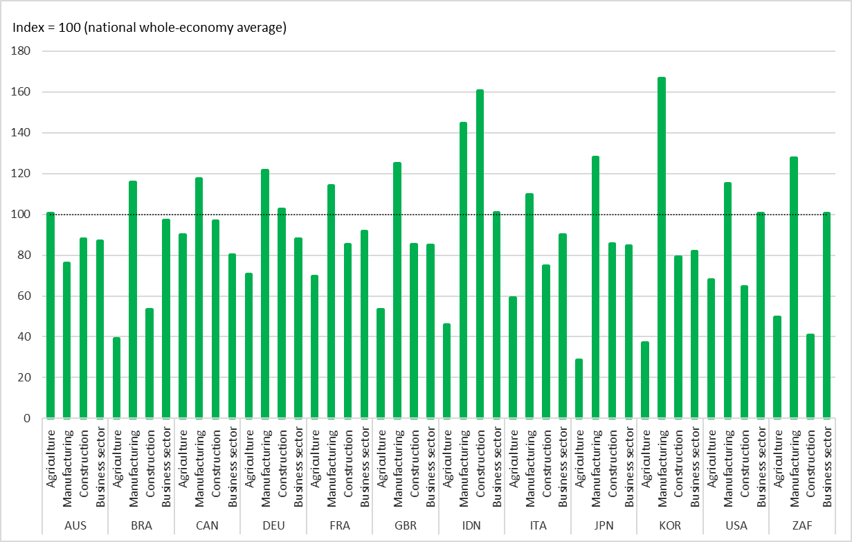
Cross-sector variations in Labour Productivity are also significant
Sector-based labour productivity levels in selected G20 economies, 2020
Productivity levels (value added per person employed) as a ratio to the national labour productivity average (whole economy)
Note: Business sector excludes agriculture, real estate activities and non-market sectors. Sector-based labour productivity levels are presented as a ratio of each national average labour productivity (whole economy).
Source: OECD Productivity Statistics database, April 2022

Slide 6
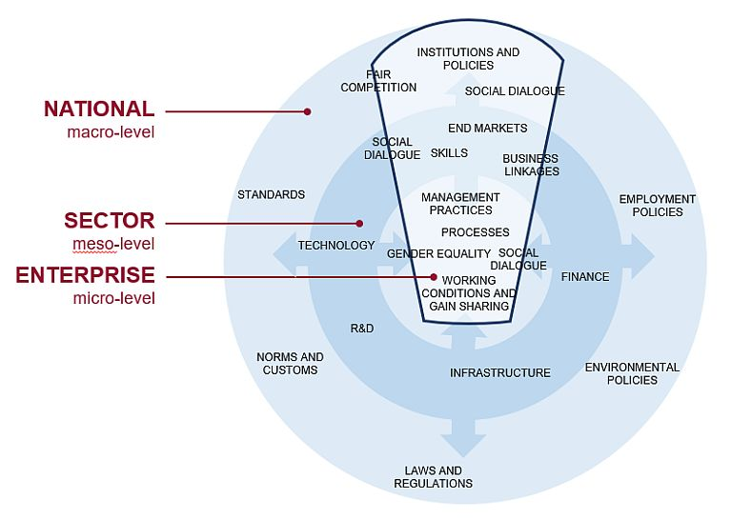
Productivity ecosystem for decent work
Productivity Ecosystem Conceptual Framework
with a "Slice" of the Ecosystem Selected
Notes:
We now move to the central part of the report that presents the main elements of the Productivity Ecosystem for Decent Work framework
As productivity drivers interface between enterprise, sector and national policy level it is important that the issue of MSME productivity is addressed in an integrated way across the 3 levels
The ecosystems approach is looking beyond the immediate visible symptoms to understand the root causes of the productivity challenges for MSMEs.
To deliver, this approach requires institutional players and private sector stakeholders to partner and work together in an integrated way.

Slide 7
Policy level drivers of productivity
MSME productivity and decent work
Enabling business environment
Employment policies with social protection + skills
Transitions to formality
Social dialogue
Inclusive Growth
Notes:
So, in reality, productivity drivers interface across policy, sector and firm levels. But to make these drivers discussable, we have parsed them out in the report.
Let’s look at some key drivers of productivity and decent work within a larger productivity ecosystems framework.
At the policy level we need:
An enabling business environment as perquisite for a productive growth of enterprises and in particular
Efficient tax regulation and business registration procedures are key to supporting MSMEs, who tend to lack specialized staff and resources to navigate complex regulations
Access to finance and credit conditions favorable to MSMEs are essential to helping MSMEs cope with shocks such as the COVID-19 pandemic, invest in business and enhance productivity
An employment policy framework that offers adequate social protection and upskilling and reskilling opportunities to workers in MSMEs
Focus on enterprise formalization : Policies that enable transition to formality as business informality and low productivity are closely related and promoting transitions to formality is therefore essential
Meaningful social dialogue : Social dialogue can support productivity enhancing-policies by ensuring policy coherence and strengthening the relationship between productivity and working conditions
Access to social protection is associated with productivity gains by facilitating formalization, asset creation and labour mobility

Slide 8
Sector and firm level drivers of productivity
National level
Sector level
Access to foreign markets
Firm level
Managerial skills
Workforce skills
Improving working conditions
Notes:
Zooming in on policy drivers at the sector and firm level:
Sector- and firm-level drivers relate to market access, skills, and the relationship between productivity and decent work.
A sectorial and firm lens is important to ensuring that policy responses are relevant to the productivity and decent work dynamics of a given context
Access to foreign markets boosts MSME productivity yet only a minority of MSMEs are able to access export markets
Workforce skills are a key driver of productivity and ensuring MSME worker access to learning opportunities is essential
Key productivity and decent work drivers at firm-level
Managerial skills are a key determinant of productivity yet MSME managers tend to exhibit low managerial skill
Improvements in working conditions in firms contribute to productivity growth and vice-versa

Slide 9
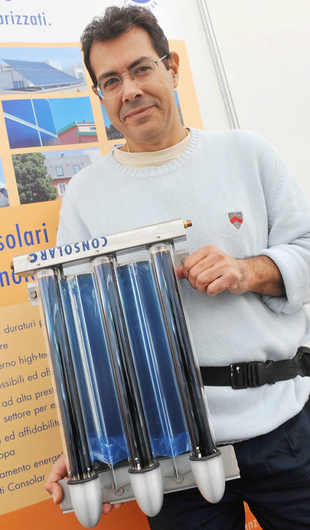
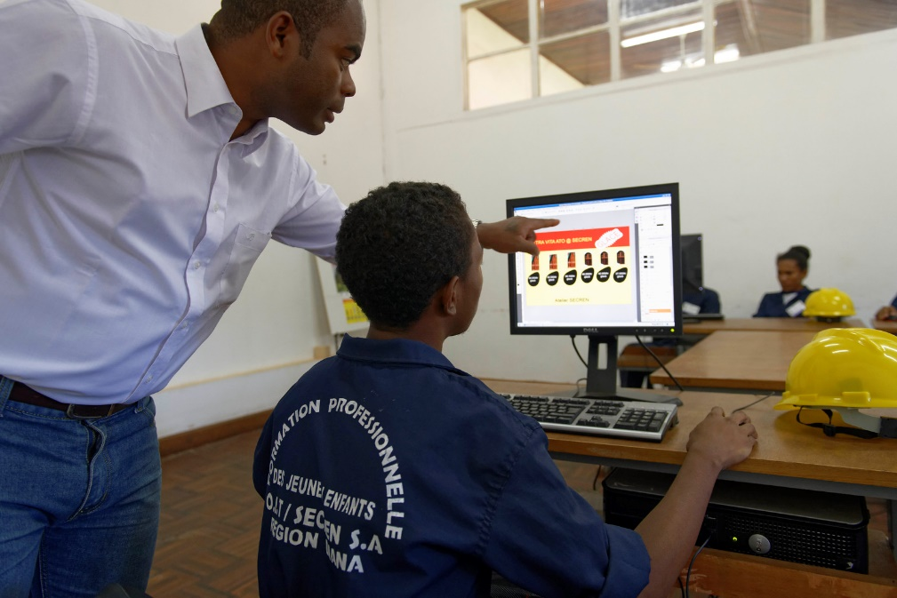

Technology, environmental sustainability and gender equality are crucial for productive and inclusive growth
Notes:
Technology
Digitalization can open up new opportunities for MSMEs and may translate into productivity growth in the medium-term
Digital adoption is most effective when combined with complementary investments in skills upgrading and reforms to the business environment
Environmental sustainability
Transition to more environmentally-friendly production processes can boost MSME productivity and job quality
Capacity building and access to finance to help MSMEs overcome the up-front investment costs are required to support MSMEs’ green transition
Gender
Women entrepreneurs continue to face constraints in terms of access to markets, training, and finance. They also remain under-represented in export-oriented and growth sectors such as technology and high-tech related sectors. Policy measures to promote women entrepreneurs' access to support services and to sectors in which they are underrepresented is therefore crucial.

Slide 10
Main policy leads
Strengthen MSME productivity through a coordinated and systemic approach (i.e. Productivity Ecosystems for Decent Work Framework).
Introduce an employment policy framework that offers adequate social protection and upskilling and reskilling opportunities to workers in MSMEs.
Develop an integrated approach to workforce skills upgrading that is tailored to industry needs and built upon consultation with social partners.
Encourage meaningful social dialogue to ensure that MSME productivity policies are informed by and address the needs of employers and workers.
Support the upgrading of managerial skills through training, mentoring and coaching services, including through the establishment of a networks of business development service providers

