Slide 1
Possible inclusion of OSH within the framework of fundamental principles and rights at work: Current state and future prospects
2nd meeting of the G7 Employment Task Force
Dortmund, 28-29 March, 2022
Martha Newton, Deputy Director-General for Policy, ILO
Notes:
Good morning, good afternoon everyone. I am honored to join you today at this G7 Employment Task Force Meeting to discuss the very important and timely topic of safety and health in the world of work as we look toward the possible inclusion of OSH within the framework of fundamental principles and rights at work this year.

Slide 2
Global OSH challenges: A changing world of work
A global challenge: almost 2 million deaths from occupational risk factors globally in the year 2016
Global supply chains
Demographic shifts and migration
Digitalisation
Automation and robotics
Changes in work organisation
Psychosocial risks + violence and harassment
Notes:
OSH is more relevant than ever. Although we have seen improvements in occupational safety and health, high rates of accidents, injuries, exposures and deaths continue to pose a global challenge. In 2021, the ILO and WHO released new estimates suggesting that, globally in the year 2016, almost 2 million people died due to exposure to 41 pairs of occupational risk factors and health outcomes.
Most fatalities that occurred were found to be due to exposure to long working hours, which was responsible for 745,000 deaths globally. Exposure to occupational particulate matter, gases and fumes also resulted in 450,000 deaths, with occupational injuries responsible for around 363,000 deaths.
The COVID-19 pandemic further emphasized the critical importance of occupational safety and health and demonstrated that the lack of a sound and resilient OSH system can have negative impacts on human wellbeing, economies and societies at large.
New challenges – see talking points

Slide 3
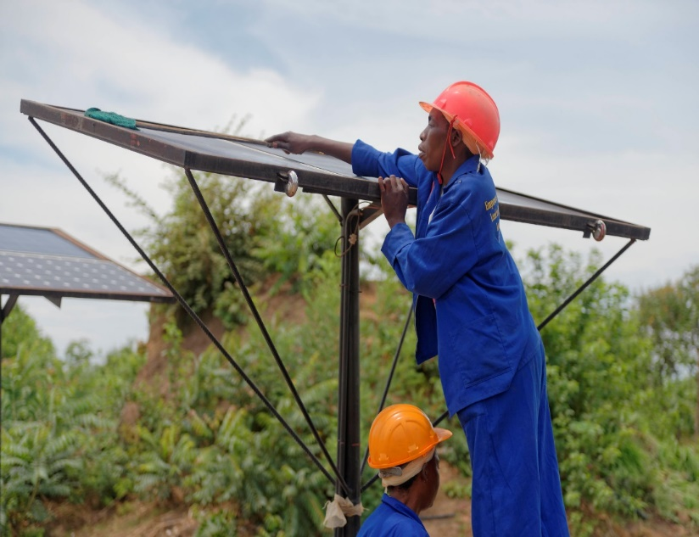
Global OSH challenges: The threat of climate change
Heat stress
Reduction in geographical areas where work is possible
Extreme weather events
Work-related health effects
Green jobs and new risks
Notes:
Focusing particularly on the global challenge of climate change – what do we see as the major implications for safety, health and wellbeing in the world of work?
As temperatures rise, heat stress will render 2 percent of all working hours as too hot to work by 2030, resulting in a loss of 72 million full-time jobs. The rise in temperatures will also result in a reduction in areas where work is possible. Due to heat, rising sea levels and other factors, many geographical areas will become impossible to work in. Climate change continues also to contribute to an increase in extreme weather events. In the aftermath of these tragedies, workers involved in emergency and clean-up work may be at increased risk of exposure to chemical and infectious agents, hazards and psychological risks.
In general, workers in many sectors will likely face other adverse health effects such as heat stroke, heat exhaustion, poorer cognitive function, increased risk of injury or safety lapses, dehydration, respiratory and cardiovascular diseases, cataracts, skin and eye cancer and weakened immune function.
Green technology works to reduce and mitigate the effects of climate change and can even help reduce OSH risks by utilizing new technology. However, green jobs associated with these technologies can also come with new, unforeseen risks to workers which must be addressed.
The ILO is currently engaged in research on the implications of climate change as well as solutions to mitigate its OSH effects, namely through the Vision Zero Fund. This biennium, we will be able to share our findings and conclusions with you on this important topic.

Slide 4
ILO Declaration on Fundamental Principles and Rights at Work
Adopted in 1998, the Declaration commits Member States to promote, respect and realize principles and rights in four categories, whether or not they have ratified the relevant Conventions
Current Categories of Fundamental Principles and Rights at Work:
Freedom of association and the effective recognition of the right to collective bargaining
The elimination of forced or compulsory labour
The abolition of child labour
The elimination of discrimination in respect of employment and occupation
These rights are universal and apply to people in all States, regardless of the level of economic development
This Photo by Unknown Author is licensed under CC BY-NC-ND
This Photo by Unknown Author is licensed under CC BY-NC
Notes:
In 2019, the ILO Centenary for the Future of Work recognized that safe and healthy working conditions are fundamental to decent work and since then we have made progress on the possible inclusion of OSH in the ILO FPRW framework. You may ask why is this important.
The ILO Declaration on Fundamental principles and rights at work adopted in 1998 recalled the obligations of ILO Member States regarding the principles and rights set out in the ILO Constitution and the Declaration of Philadelphia, and which have been expressed and developed in the form of specific rights and obligations in Conventions recognized as fundamental. These human rights are enabling conditions to the pursuit of the improvement of individual and collective conditions of work.
There are currently four categories of fundamental principles and rights at work, which are universal and apply to people in all States.
See talking points

Slide 5
The importance of including OSH within the framework of FPRW
ILC: Centenary Declaration for the Future of Work declares that “[s]afe and healthy working conditions are fundamental to decent work”
2019: resolution requesting the Governing Body “to consider, as soon as possible, proposals for including safe and healthy working conditions in the ILO’s framework of fundamental principles and rights at work”
2022: decision on an amendment to the ILO Declaration on FPRW adding safety and healthy working conditions/ working environment as fifth category of FPRW
Notes:
As I mentioned before, recognizing the importance of promoting a safety and health culture, the 108th Session (2019) of the International Labour Conference declared in the Centenary Declaration for the Future of Work that “[s]afe and healthy working conditions are fundamental to decent work.” The Conference adopted a resolution requesting the Governing Body “to consider, as soon as possible, proposals for including safe and healthy working conditions in the ILO’s framework of fundamental principles and rights at work”.
The inclusion of OSH within the ILO’s framework of fundamental principles and rights at work has been since then the object of discussions at the ILO Governing Body in its recent sessions, which has decided to place it on the agenda of the 110th Session of the International Labour Conference in June this year.

Slide 6
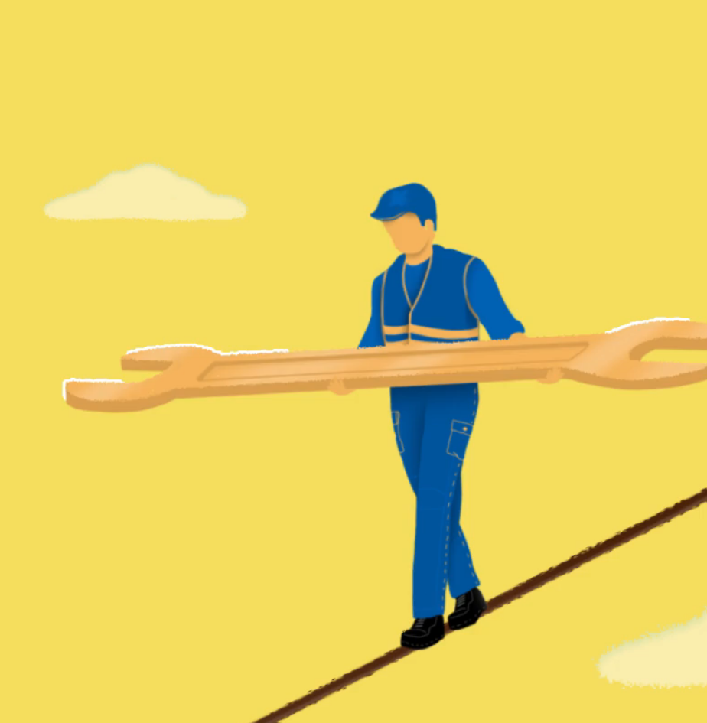
The Draft Conference Resolution
344th Governing Body: inclusion of OSH within the framework of FPRW should take the form of a Conference resolution amending the 1998 Declaration
OSH shares the same constitutional basis as the existing 4 fundamental principles
Under an amended Declaration, Member States would have an obligation to promote, respect and realize in good faith the principle of protection of safe and healthy working [conditions/environments]
Instruments currently discussed: Convention No. 155, Convention No. 161, Convention No. 187 and the Protocol of 2002 to C155
Notes:
During the 344th Session of the Governing Body, it was decided that the inclusion of OSH within the Framework of fundamental principles and rights at work should take the form of a Conference resolution amending the 1998 Declaration.
The preamble of the ILO Constitution and the Declaration of Philadelphia contain express references to “protection against sickness, diseases and injury arising out of employment” and “adequate protection for the life and health of workers in all occupations”. In this way, OSH shares the same constitutional basis as the existing fundamental principles and rights at work.
If included under an amended Declaration, member States would have an obligation to respect, promote and realize the principle of protection of OSH in good faith alongside the other existing categories of principles and rights.
The Governing Body or International Labour Conference will also decide which instruments to be designated as fundamental. Currently, discussions focus on the Occupational Safety and Health Convention (No. 155), the Occupational Health Services Convention (No. 161), the Promotional Framework for Occupational Safety and Health Convention (No. 187) and the Protocol of 2002 to the Occupational Safety and Health Convention.

Slide 7
Implications for Follow-up
The Declaration and its Follow-up provides three ways to assist countries, employers and workers achieve the full realization of the Declaration’s objective:
Annual Review Reports: This reporting process provides Governments with an opportunity to state what measures they have taken towards achieving respect for the Declaration
Recurrent discussions at the ILC: Provides a dynamic global picture of the current situation
Development Cooperation Projects: Projects designed to address identifiable needs in relation to the Declaration and to strengthen local capacities thereby translating principles into practice
Notes:
If OSH is to be included within the framework of FPRW, the Declaration and its Follow-up provide three ways of assisting countries in realizing the objectives of the Declaration.
Through annual review reports, governments have the opportunity to state what measures they have taken towards achieving respect for the Declaration. This is particularly key for member States which have not yet ratified one or more of the ILO Conventions directly related to the specific principles and rights. This process also gives employers and workers organizations an opportunity to voice their views related to progress and actions taken.
Global reports provide a dynamic global picture of the overall situation related to the principles and rights expressed in the Declaration. Global reports examine global and regional trends and highlight areas in need of greater attention. These reports can help determine priorities for technical cooperation projects.
Finally, technical cooperation projects address identifiable needs and work to strengthen local capacities in relation to the Declaration, translating the principles into practice. The ILO is already quite active on providing support to countries on OSH through the Flagship Programme Safety and Health for All, covering over 138 million workers as potential beneficiaries in 19 countries. The Vision Zero Fund is an important component of the Programme, with a focus on global supply chains.

Slide 8
The critical role of the G7 in supporting OSH as a potential FPRW
Supporting member states in integrating OSH into their FPRW frameworks and labour legislation
Promoting ratification of ILO instruments on OSH
Strengthening social dialogue to promote OSH
Promoting OSH initiatives along global supply chains
Strengthening effective national OSH policies and regulatory frameworks
Capacity building of national OSH institutions and world of work stakeholders
Strengthening OSH management systems at the enterprise level
Support development cooperation initiatives to strengthen national OSH systems
Notes:
The G7 has a critical role to play in promoting OSH as potentially part of a new framework of fundamental principles and rights at work.
First, the G7 can support member States to integrate OSH into existing frameworks and labour legislation, as well as encouraging and promoting ratification of ILO international labour standards on OSH by member States which have not done so already.
The G7 can encourage strengthening of social dialogue on OSH, including the establishment of tripartite mechanisms at the national level.
It will continue to be important to promote OSH initiatives along global supply chains. In another session, you will hear more about the model of collective action promoted by the ILO Vision Zero Fund. We will discuss how the Fund can assist in promoting OSH in global supply chains, namely in face of new due diligence requirements.
The G7 can also support strengthening national OSH policies and can work toward capacity building of national OSH institutions. At the enterprise level, we should also continue to work toward strengthening OSH management systems. The Office is currently working on new resources for the implementation of the ILO guidelines on OSH management systems that will assist in particular smaller enterprises to address and manage OSH risks.

Slide 9
Thank you

